Slide 1


Analyzing Bike Share Insights
By
Vasavi Veerla

Slide 2
Introduction
Bike Share: The system that allows individuals to rent bikes for short trips on a pay-per-use basis.
Factors Influencing Bike Share Demand:
Urbanization: The demand for bike share is higher in densely populated areas with shorter distances between destinations.
Weather Conditions: Seasonal variations affect the demand for bike share, with better weather leading to increased usage.
Infrastructure: Availability of bike lanes, bike parking facilities, and safe cycling routes positively impact demand.
Time: Bike share experiences spikes in demand during work starting and closing hours.
Public Awareness: Effective marketing and public awareness campaigns can boost usage.

Slide 3
Questions to be Answered?
a) How does bike sharing demand vary across different times of the day, days of the week, and seasons?
b) Can we predict future bike-sharing demand based on historical patterns and external factors?
c) How do weather or other external factors impact bike-sharing demand?

Slide 4
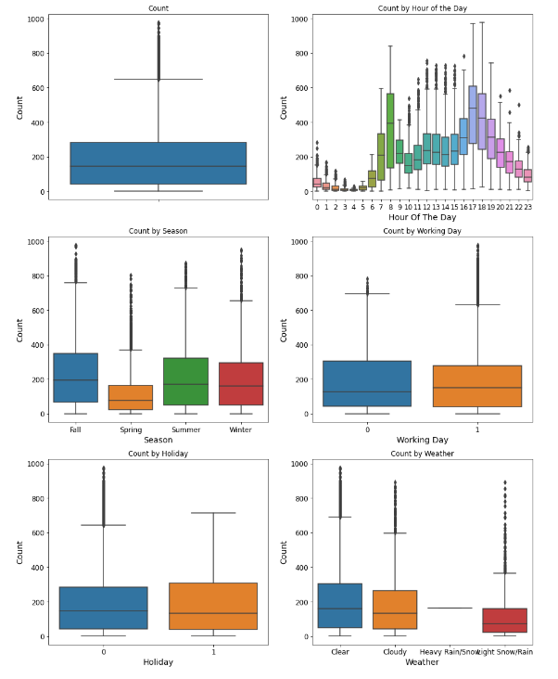
Data Analysis of Bike Share Demand using visualization
Analysis: The boxplot with meaningful information is the Hour of the day because it shows the busiest hours are 7AM-8AM and 5 PM-6 PM, which means the users mainly rent bikes to ride to work/school and to return back home at the end of the day. Based on boxplots 4 and 5 (Working Day and Holiday), we see most outliers are in working days. The result makes sense when looking at holidays since all outliers are for non-holiday days. The last boxplot demonstrates the obvious common sense that most users rent bikes when the weather is Clear and Cloudy (1 and 2), and almost no users when is heavy raining or snowing (3).

Slide 5
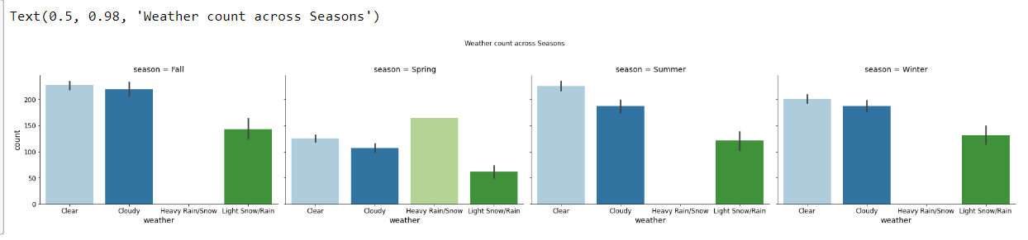
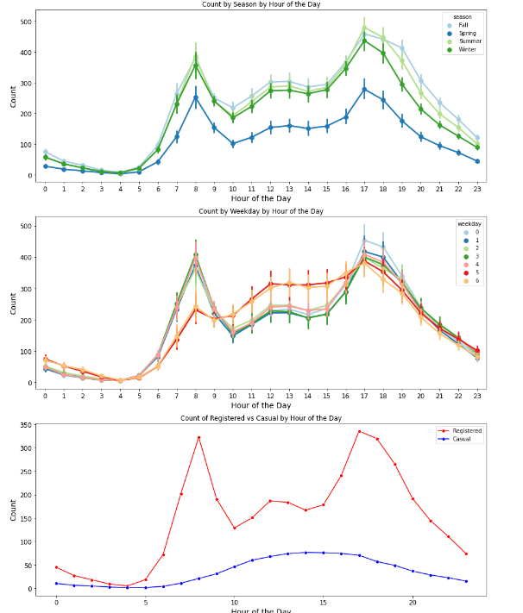
a) How does bike sharing demand vary across different times of the day, days of the week, and seasons?

Slide 6
Predictive Analysis
Types of Machine Learning Algorithms I used for Demand Prediction
Linear Regression Model
Random Forest Model
Gradient Boost Tree Model
Extreme Gradient Boost model
For all these Root Mean Squared Logarithmic Error
Linear Model: 0.2
Random Forest: 0.08
Gradient Boost Tree: 0.09
XG Boost: 0.08

Slide 7
Best Prediction model
Since Extreme Gradient Boost model - XG Boost has the least RMSE which is 0.08 (Root Mean Squared Logarithmic Error) we have chosen that one for our prediction and the accuracy for that is 97.1 %

Slide 8
Conclusion
As we embrace the transformative power of Machine Learning for demand prediction, businesses can unlock new possibilities for operational efficiency and customer satisfaction.
As cities strive to create cleaner, healthier, and more accessible environments, bike-share systems offer a remarkable solution.

Slide 9
Thank you

